Slide 1
Evaluator of HIV-RT Personnel Competency TOT:
Training Overview

Slide 2
Goal of the TOT
To develop a pool of competent evaluators/trainers who will train more evaluators of HIV-RT personnel competency in support of the >>>MOH or Certification body<<<’s initiative to roll-out personnel certification, ensuring qualified, competent testers performing HIV-RT

Slide 3
TOT Objectives
Upon successful completion of this workshop, participants will be able to;
Identify attributes and competencies of an evaluator of HIV-RT personnel competency.
Develop an in-depth understanding of the personnel competency assessment tools.
Demonstrate the required skills/knowledge to perform effective personnel competency assessments.
Train others to successfully serve as evaluators of HIV-RT personnel competency.

Slide 4
What to Expect from this TOT
This workshop will be:
Prescriptive
  Provides activities/tasks/tools for you to use at your sites
Interactive
  An opportunity to discuss, interact, and share experiences with fellow colleagues (i.e. learn from each other’s experiences)

Slide 5
TOT Agenda Overview
Day 1
  Pre-training written assessment
  In-depth didactic and hands-on training in personnel competency assessment tools and the role/expectations of an evaluator
Days 2 & 3
  Practical examples and group work related to evaluator role
  Field practical assessment sessions to cultivate and ensure successful assessment and observation practices during HIV-RT personnel competency assessment
  Facilitator feedback and open discussions

Slide 6
TOT Agenda
Day 4
  Post-training written assessment
  Preparation and group report backs on field practical sessions
  Facilitator feedback
  Open discussion
  Written examination administration
  Implementation strategy for roll-out
  Workshop evaluation
  Closing ceremony and certification

Slide 7


Ground Rules / Expectations
Group decides the ground rules and their individual expectations for this workshop!
Notes:
Write their individual expectations on a flip chart and go over the flip chart on the 3rd and 4th day to show how expectations are being met (or not)- this helps to keep facilitators on track and participants motivated and interactive!
Use flip chart to write the groups’ Ground Rules – this reminds everyone of their responsibilities for the week

Slide 8
Ground Rules / Expectations - Suggested
Silence cell phones
Participate 100%
Respect each others’ thinking and value their contributions
Show up and CHOOSE to be present
Staying on schedule is everyone’s responsibility; honor time limits
With transformation, expect anxiety
Stay open to new ways of doing things
Success depends on participation – share ideas, ask questions, draw others out
Notes:
Write their individual expectations on a flip chart and go over the flip chart on the 3rd and 4th day to show how expectations are being met (or not)- this helps to keep facilitators on track and participants motivated and interactive!
Use flip chart to write the groups’ Ground Rules – this reminds everyone of their responsibilities for the week

Slide 9
Agenda Schedule - Housekeeping
Facilitators will present a topic followed by an activity which allows participants the opportunity to practice using the information in small / large groups
There will be two Tea Breaks and a Lunch Break on Days 1 & 4
There will be only one (heavy) Tea Break on Days 2 & 3
There will be dedicated time for questions and comments each day (Parking Lot)

Slide 10
Evaluation Criteria for Participants
CRITERIA | SCORING
 | LEVEL 1 | LEVEL 2 | LEVEL 3 | LEVEL 4
 | <70% | 70-79% | 80-89% | ≥90%
Training Attendance
Pre-Training Written Assessment
Training Content Comprehension
Competency Assessment Skills
Computer Skills / Data Management Comprehension
Post-Training Written Assessment

Slide 11
Competency Levels for Participants
OVERALL COMPETENCY LEVELS Levels 1 – 4 | Level 4 Potential trainer and evaluator of personnel competency. Ready to facilitate and conduct competency assessment using both direct observation checklist and peer-to-peer observation form
 | Level 3 Needs more development as a facilitator and/or an evaluator. Should work under the guidance of more experienced evaluators.
 | Level 2 Does not have acceptable facilitation and/or evaluation skills, but understands the training package well and has inter-personnel skills. May be able to use the checklist to identify deficiencies in personnel competency.
 | Level 1 Cannot facilitate or conduct competency assessment. May be able to assist with logistic support or data management for the QAC. May be able to serve as proctor for written examination.

Slide 12
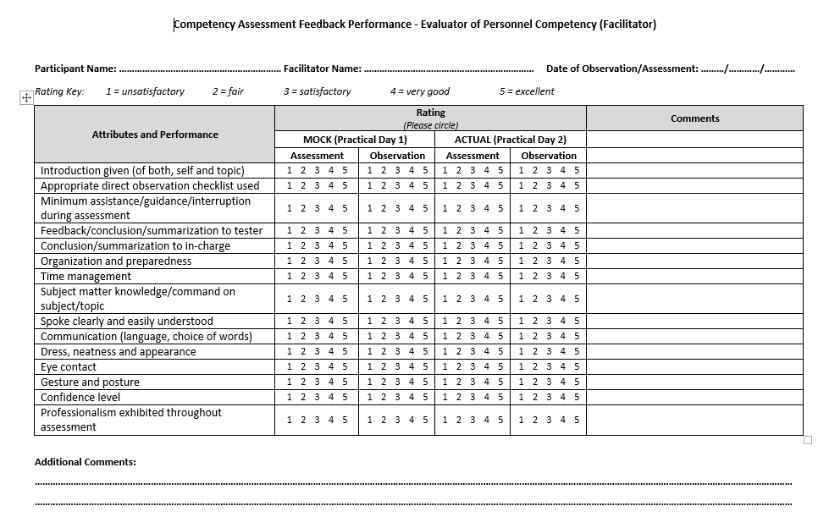
Participant Evaluation Tool – Field Practical

